Slide 1
Neural Style
Sungjoon Choi
(sungjoon.choi@cpslab.snu.ac.kr)

Slide 2
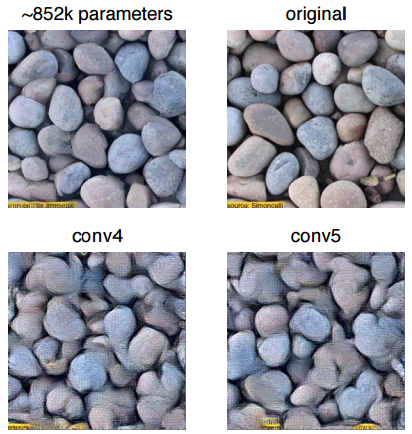
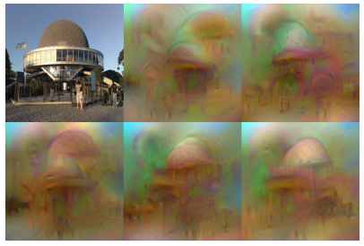
Preliminaries
Texture Synthesis Using Convolutional Neural Networks
NIPS2015
Understanding Deep Image Representations by Inverting Them
CVPR2015

Slide 3
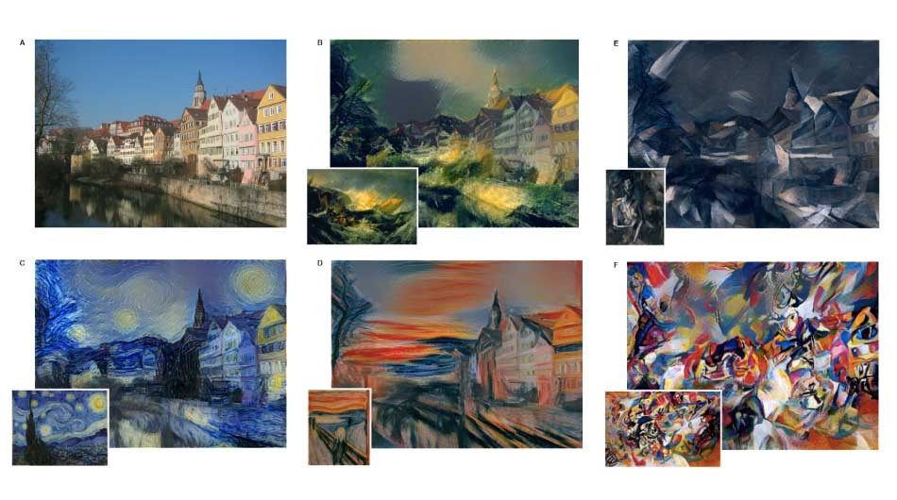
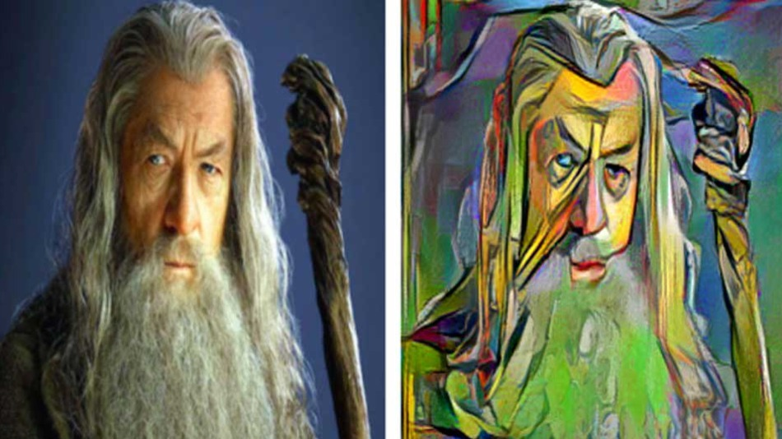
A Neural Algorithm of Artistic Style

Slide 4
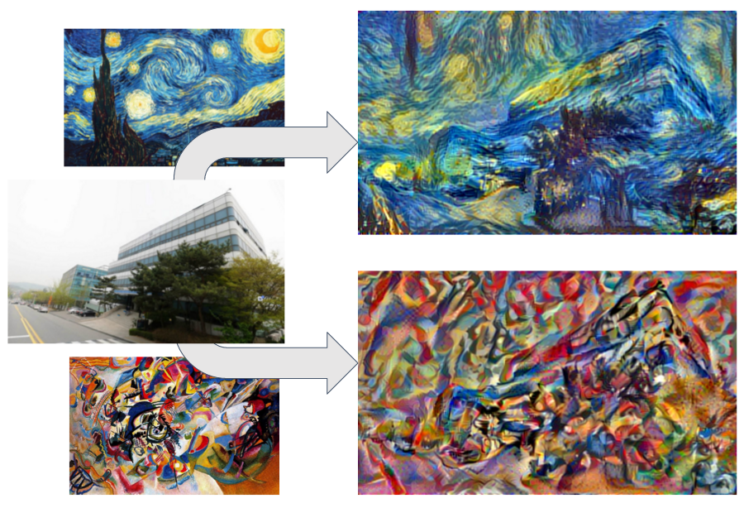
A Neural Algorithm of Artistic Style

Slide 5
Texture Synthesis Using Convolutional Neural Networks -NIPS2015
Leon A. Gatys, Alexander S. Ecker, Matthias Bethge

Slide 6

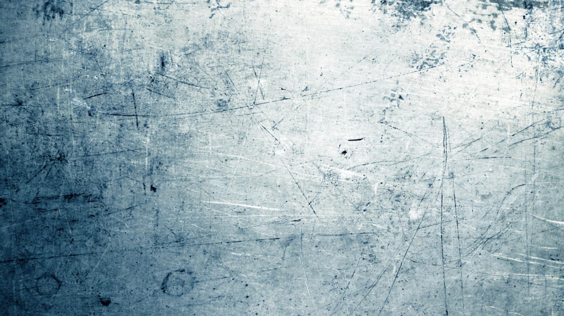
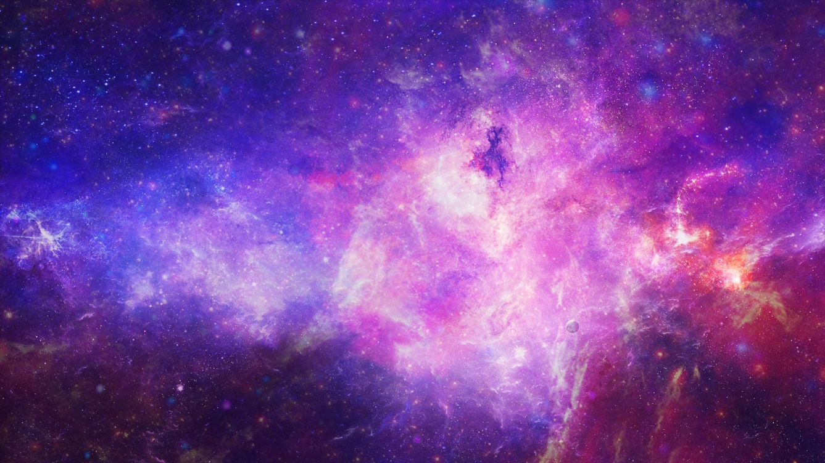
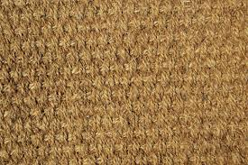
Texture?

Slide 7
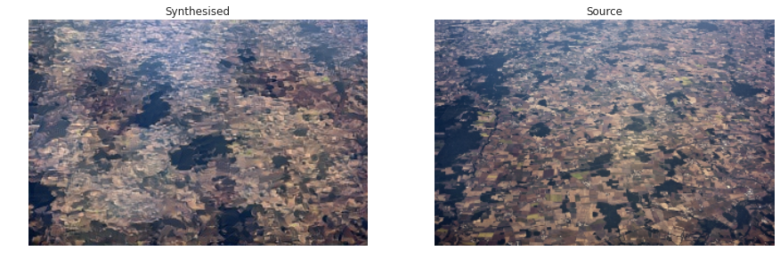
Visual texture synthesis
Which one do you think is real?
Right one is real.
Goal of texture synthesis is to produce (arbitrarily many) new samples from an example texture.

Slide 8
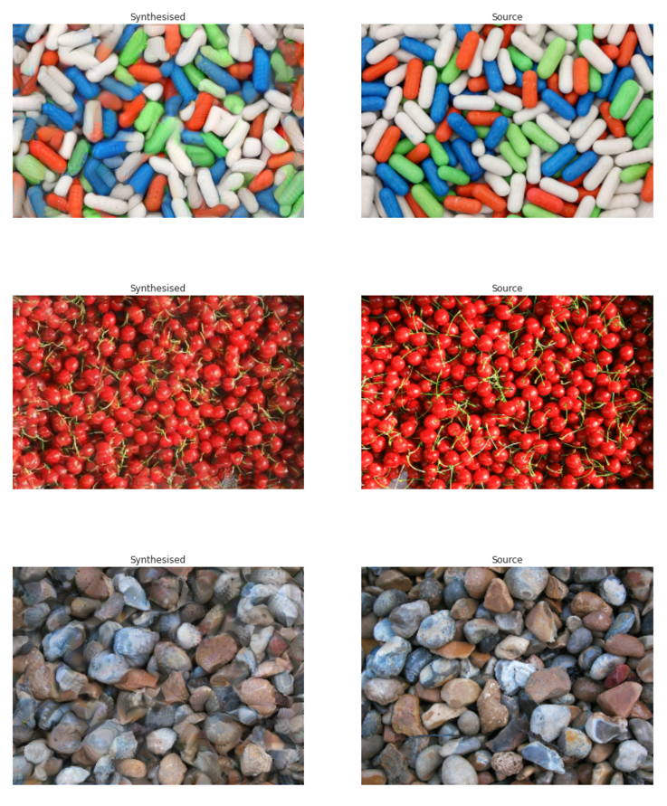
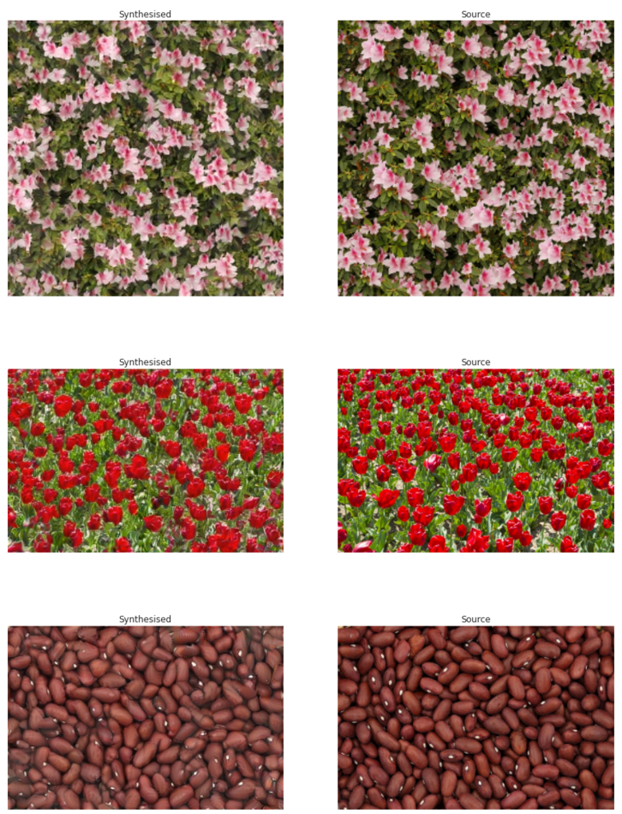
Results of this work
Right ones are given sources!

Slide 9
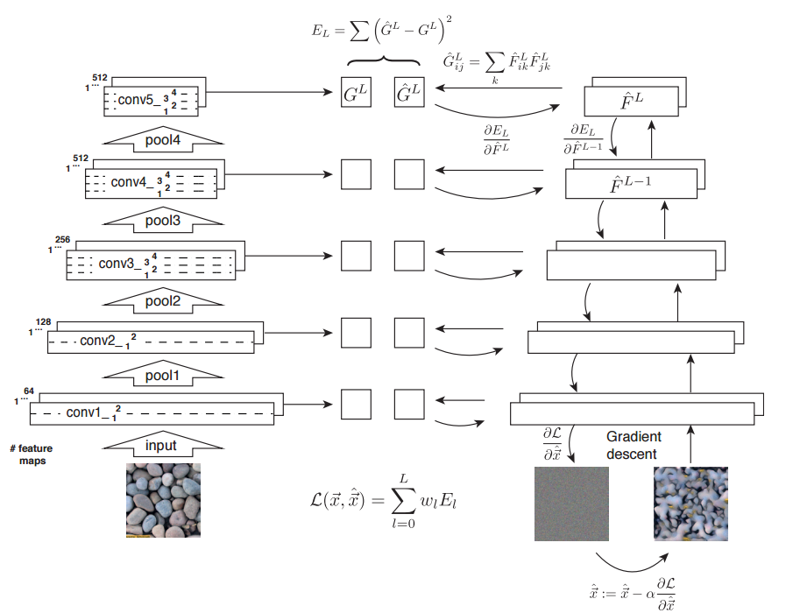
How?

Slide 10


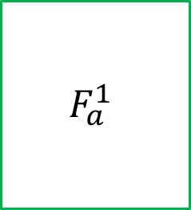
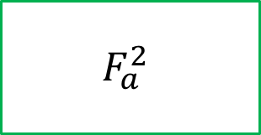


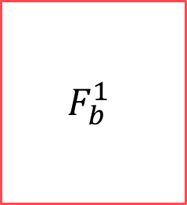


Texture Model
$$X_{a}$$
$$F_{a}^{1}$$
$$F_{a}^{2}$$
$$F_{a}^{3}$$
number of filters
Input a
$$X_{b}$$
$$F_{b}^{1}$$
$$F_{b}^{2}$$
$$F_{b}^{3}$$
Input b

Slide 11
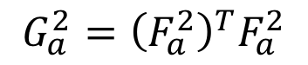
Feature Correlations
$$X_{a}$$
$$F_{a}^{1}$$
$$F_{a}^{2}$$
$$F_{a}^{3}$$
number of filters
Input a
$$G_{a}^{2}={\left(F_{a}^{2}\right)}^{T}F_{a}^{2}$$
$$X_{b}$$
(Gram matrix)
$$F_{b}^{1}$$
$$F_{b}^{2}$$
$$F_{b}^{3}$$
Input b

Slide 12
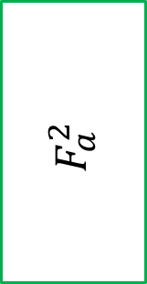
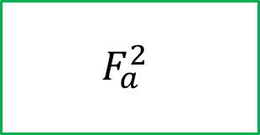
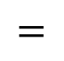
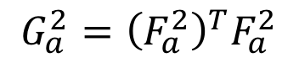
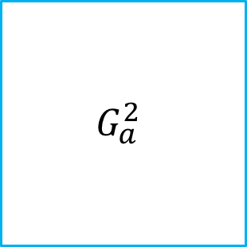
Feature Correlations
$$F_{a}^{2}$$
$$G_{a}^{2}$$
$$F_{a}^{2}$$
$$F_{a}^{2}$$
$$=$$
number of filters
$$G_{a}^{2}={\left(F_{a}^{2}\right)}^{T}F_{a}^{2}$$
(Gram matrix)
number of filters
W*H

Slide 13
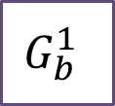





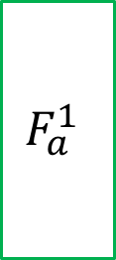
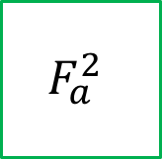


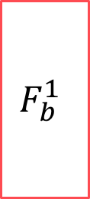

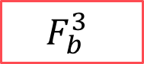

Texture Generation
$$X_{a}$$
$$F_{a}^{1}$$
$$F_{a}^{2}$$
$$F_{a}^{3}$$
$$G_{a}^{1}$$
$$G_{a}^{1}$$
Input a
$$G_{a}^{1}$$
$$G_{b}^{1}$$
$$G_{b}^{1}$$
$$G_{b}^{1}$$
$$X_{b}$$
$$F_{b}^{1}$$
$$F_{b}^{2}$$
$$F_{b}^{3}$$
Input b

Slide 14
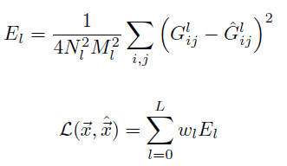
Texture Generation
$$X_{a}$$
$$F_{a}^{1}$$
$$F_{a}^{2}$$
$$F_{a}^{3}$$
$$G_{a}^{1}$$
Element-wise squared loss
$$G_{a}^{1}$$
Input a
$$G_{a}^{1}$$
$$G_{b}^{1}$$
$$G_{b}^{1}$$
$$G_{b}^{1}$$
Total layer-wise loss function
$$X_{b}$$
$$F_{b}^{1}$$
$$F_{b}^{2}$$
$$F_{b}^{3}$$
Input b

Slide 15
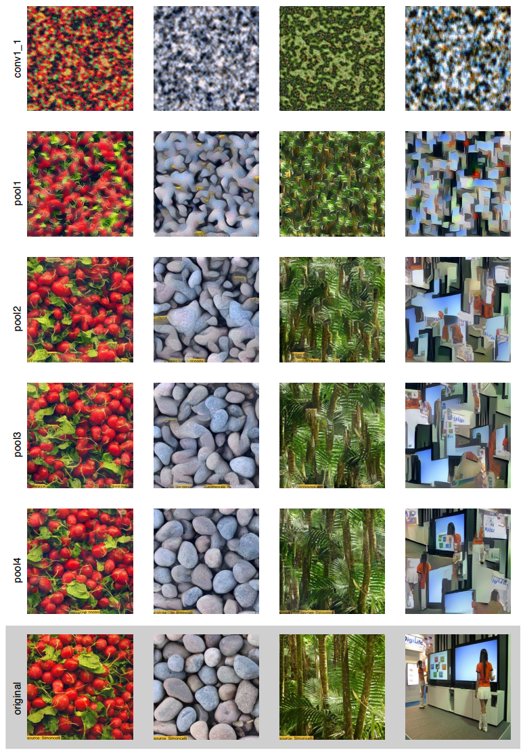
Results

Slide 16
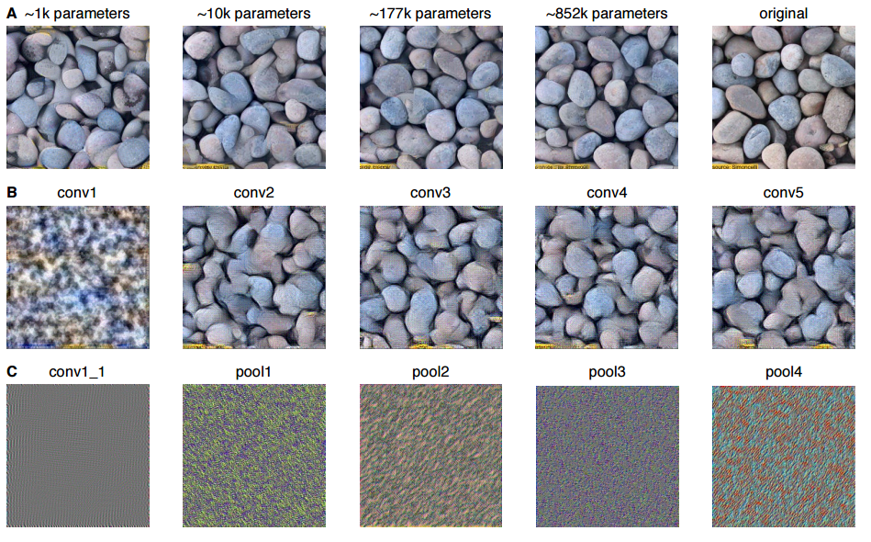
Results

Slide 17
Understanding Deep Image Representations by Inverting Them -CVPR2015
Aravindh Mahendran, Andrea Vedaldi (VGGgroup)

Slide 18
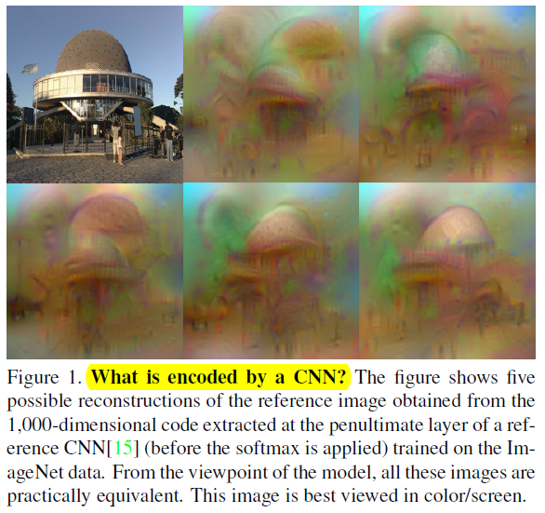
Reconstruction from feature map

Slide 19



Reconstruction from feature map
$$X_{a}$$
$$F_{a}^{1}$$
$$F_{a}^{2}$$
$$F_{a}^{3}$$
number of filters
Input a
Let’s make this features similar!
$$X_{b}$$
$$F_{b}^{1}$$
$$F_{b}^{2}$$
$$F_{b}^{3}$$
Input b
By changing the input image!

Slide 20
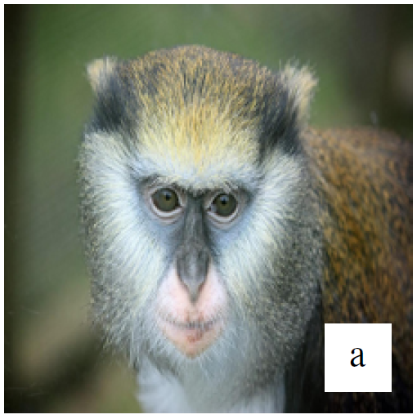
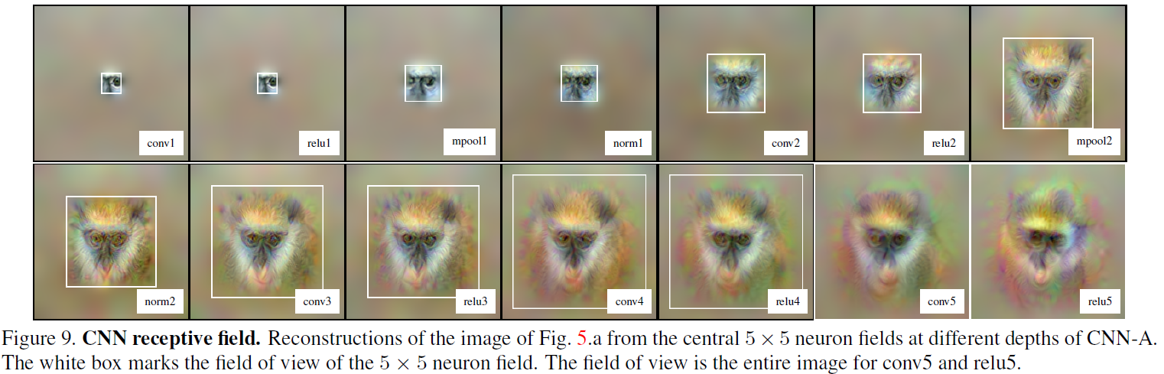
Receptive Field

Slide 21
A Neural Algorithm of Artistic Style
Leon A. Gatys, Alexander S. Ecker, Matthias Bethge

Slide 22
How?
Style Image
Mixed Image
Neural Art
Content Image

Slide 23
How?
Style Image
Texture Synthesis Using Convolutional Neural Networks
Mixed Image
Neural Art
Content Image
Understanding Deep Image Representations by Inverting Them

Slide 24
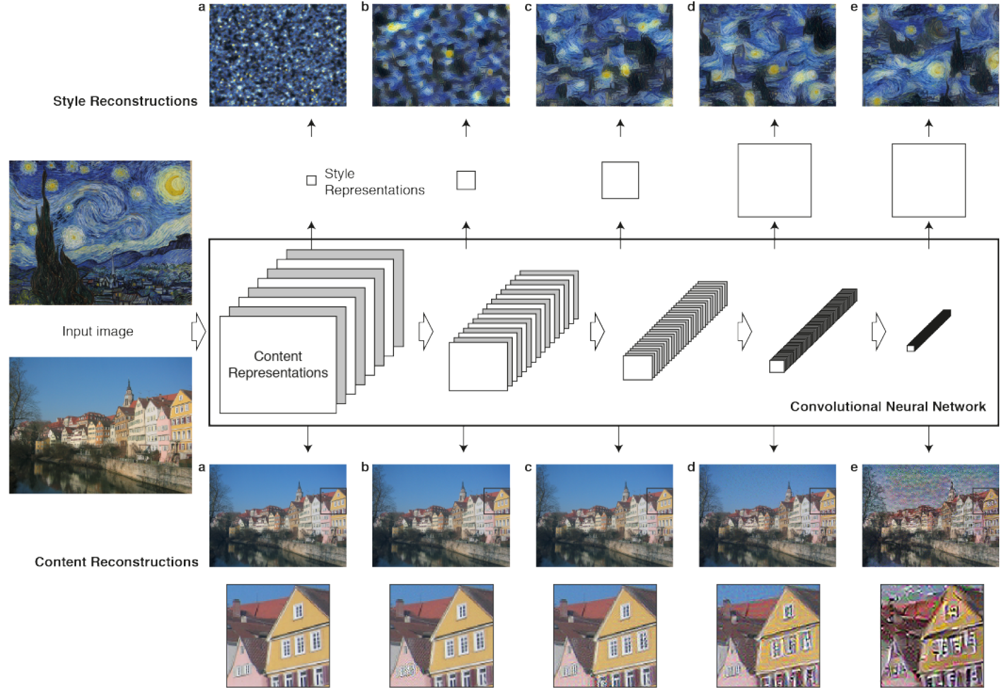
How?
Gram matrix

Slide 25
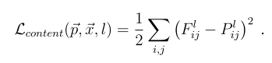
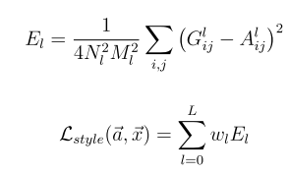
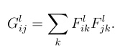
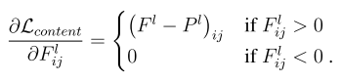
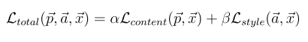
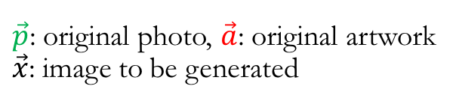
Neural Art
$\vec{p}$: original photo, $\vec{a}$: original artwork
$\vec{x}$: image to be generated
Content
Style
Total loss = content loss + style loss

Slide 26
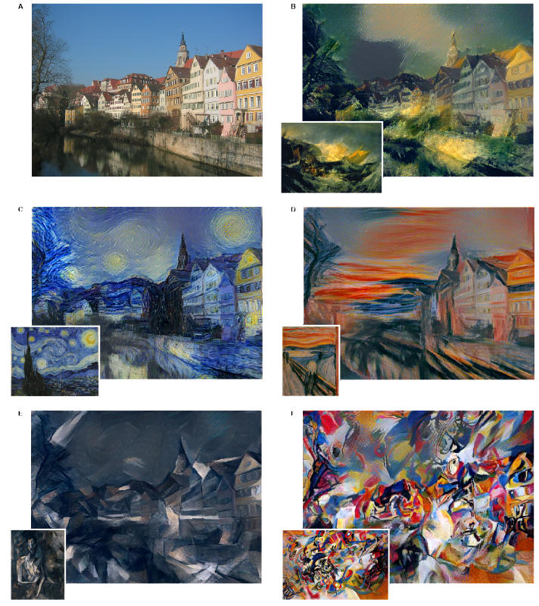
Results

Slide 27
Neural Style Implementation

Slide 28
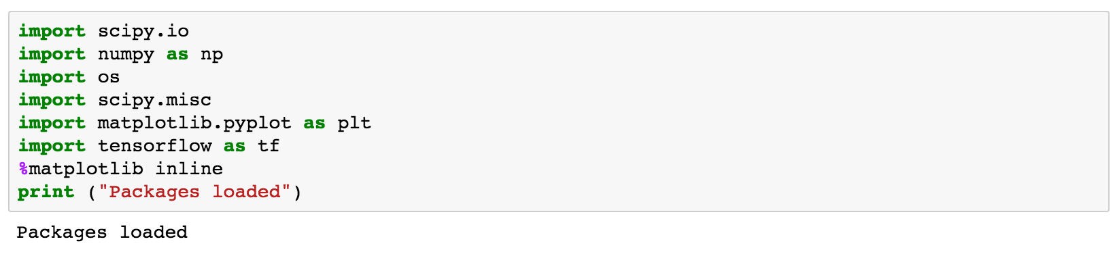
Load packages

Slide 29
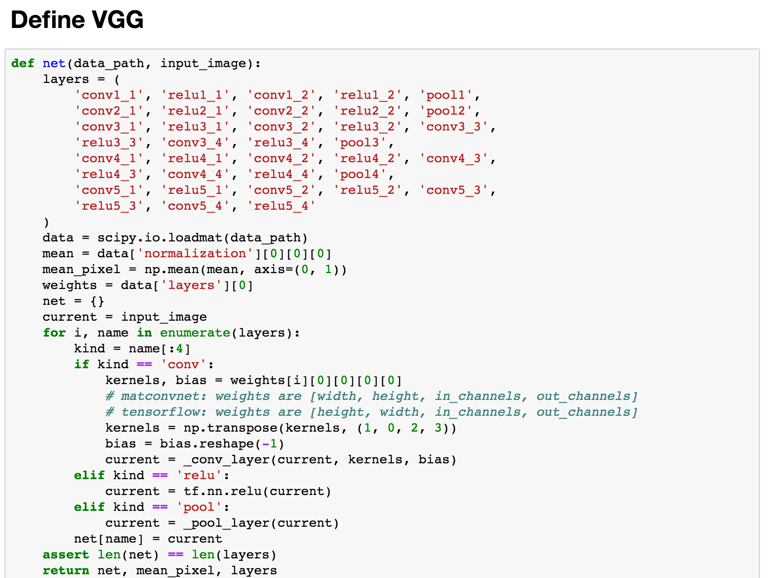
Define VGG networks

Slide 30
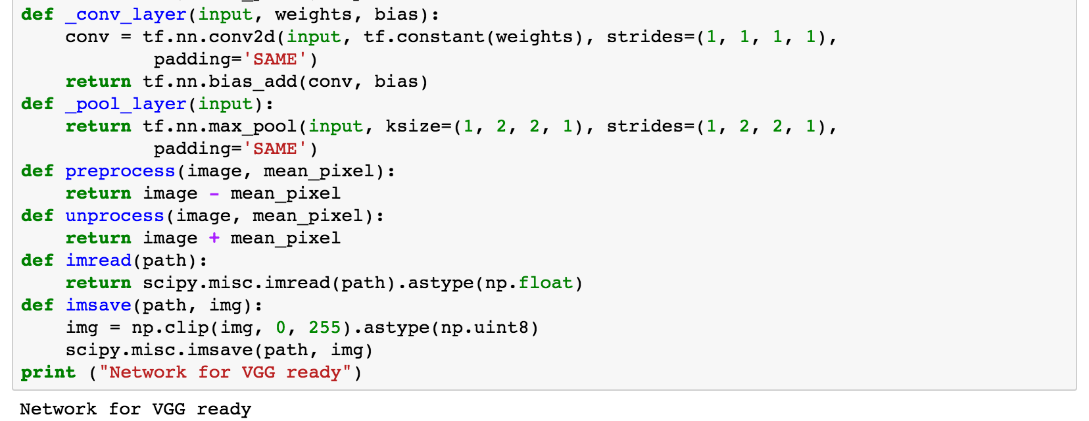
Define VGG networks

Slide 31
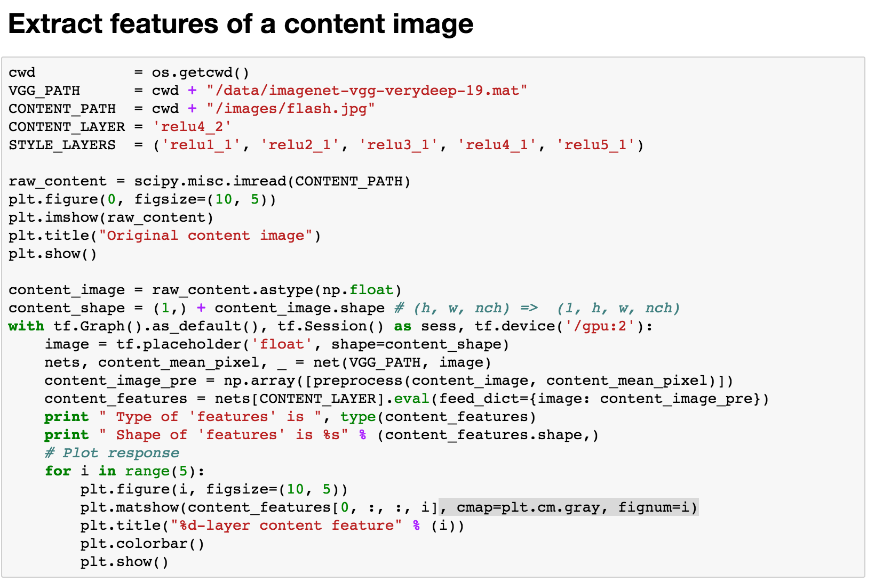

Slide 32
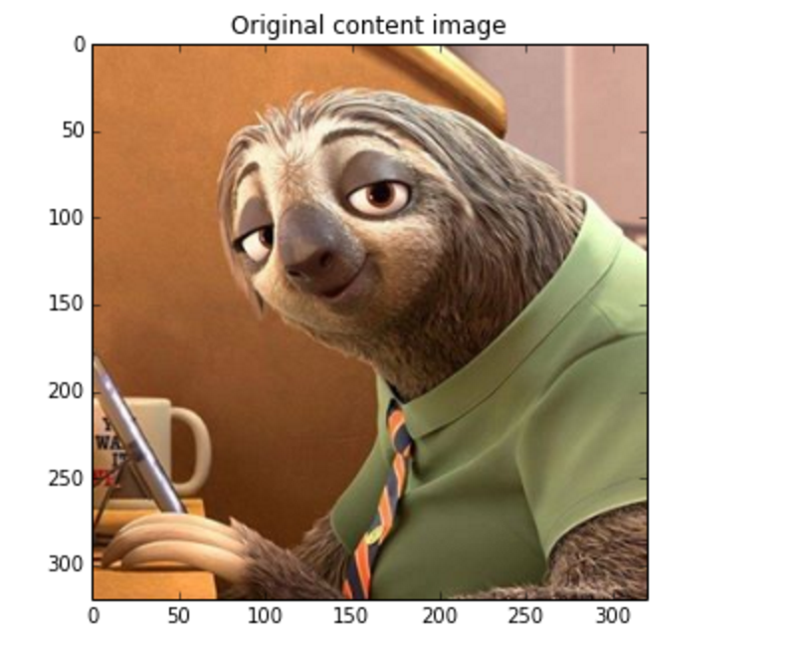
Original content image

Slide 33
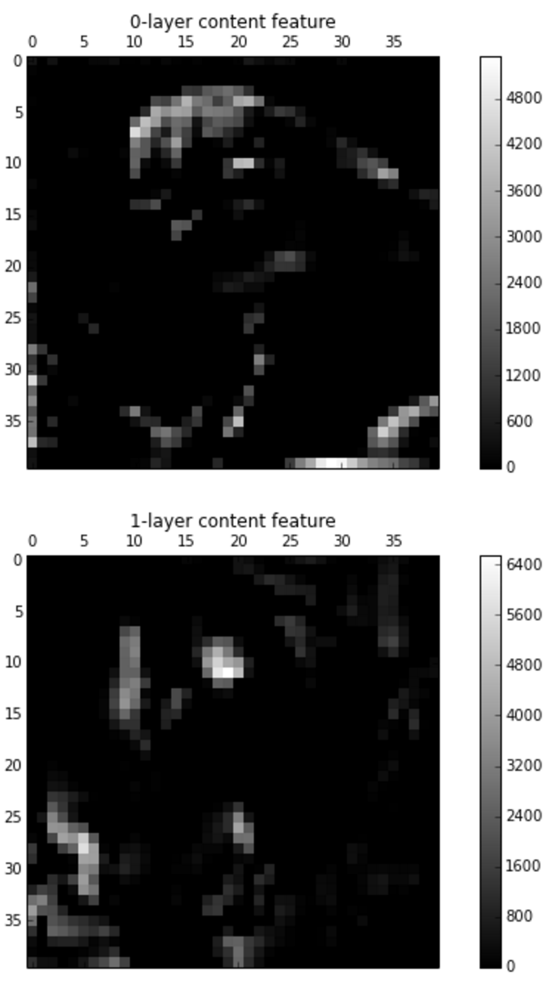
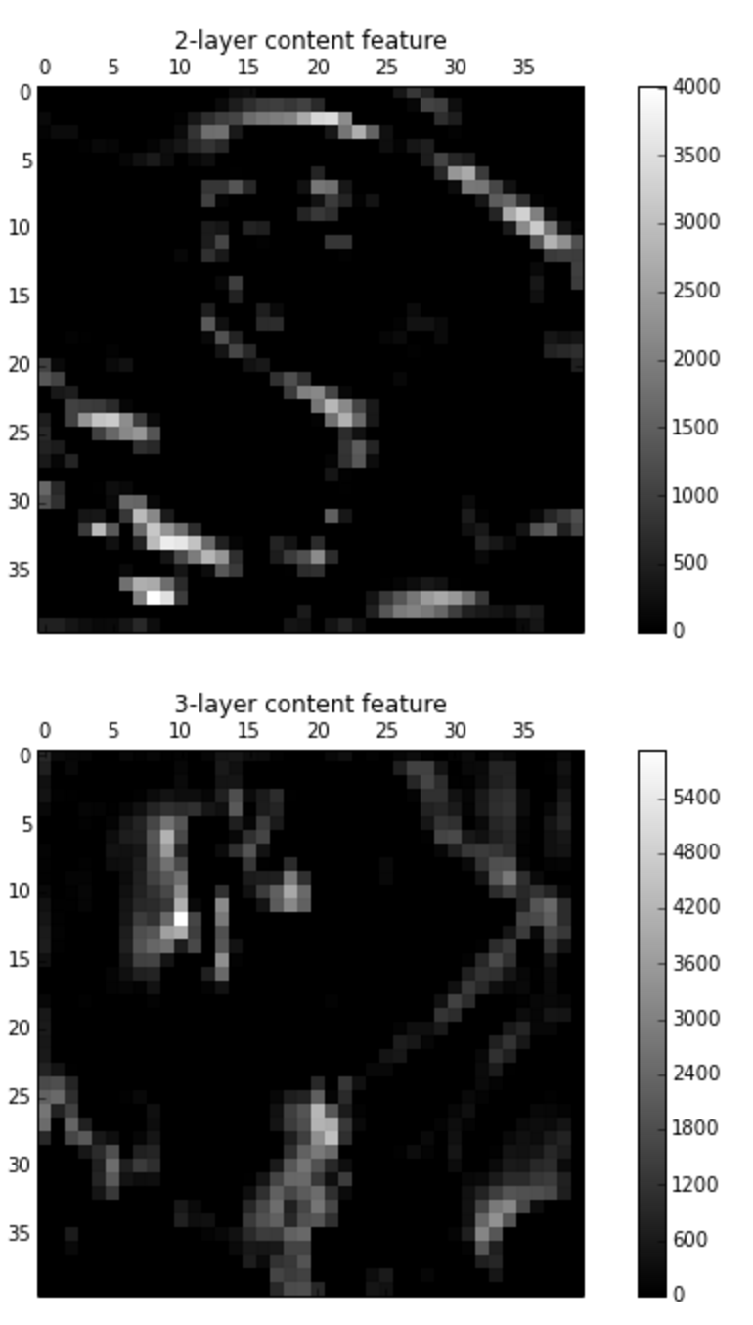
Content features

Slide 34
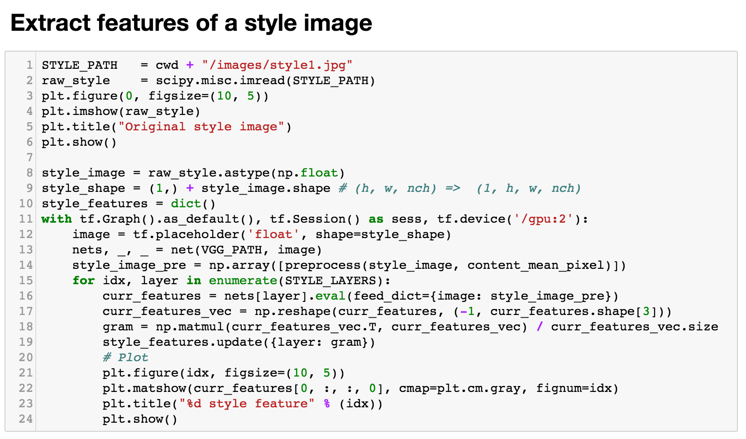
Extract features from a style image

Slide 35
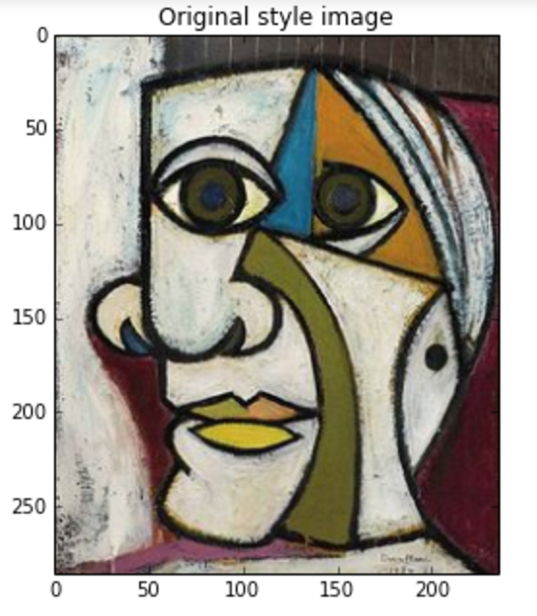
Original style image

Slide 36
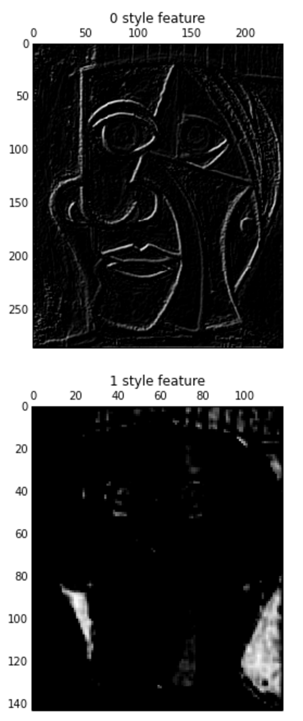


Style features

Slide 37


Slide 38

Optimize

Slide 39



Results

